Slide 1

DF
LECTURE
Computer Forensic Reporting
Diploma in CSF/IT
Year 2/3 (2022/23), Semester 4/6
Digital Forensics
8
Notes:
Left-hand Bar – Replace FSP by your module code and X by the lecture number.
Replace Lecture Title
Replace < Module Name >
Replace Year and Semester if necessary

Slide 2
Objectives
At the end of this, you will get to know more about:
How to prepare a computer forensic report.
The various sections of a typical forensic report.

Slide 3
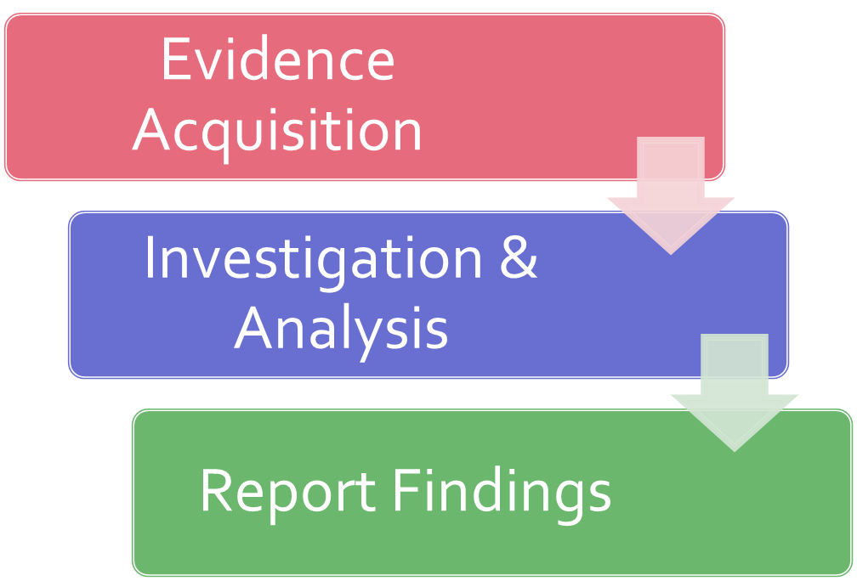
Recall: Forensics in a Nutshell

Slide 4
Documenting and Reporting
At the end of any forensic examination, you will have to report your findings.
There is no standardized report format. You have to find out what type of work product you are going to be required to produce to the client, attorney, etc. to serve as your guide for completing your report.
The report will vary in length and format. It could be just a few pages in length or maybe more than 20 pages, depending on the type of case, department/company expectations, and policy and procedure.

Slide 5
Documenting and Reporting – cont.
All documentation should be complete, accurate, and comprehensive.
The resulting report should be written for the intended audience.
It may be the supervisor, client, attorney, etc. or even to a judge and jury who will read and interpret your report after it has been cross-examined.
Are you prepared to explain your findings?
When the case goes to trial and you are called upon to testify a year or more in the future, will you be able to remember the case based simply from the details you included in your report?

Slide 6
Examiner Report
This topic provides guidance in preparing the report that will be submitted to the investigator, prosecutor, and others. These are just general suggestions.
The report may include:
Case identifier/number.
Exhibit/tag number
Identity of the examiner/ investigator.
Identity of the reporting agency.

Slide 7
Examiner Report – cont.
Date of receipt of exhibit.
Date of report.
Descriptive list of items submitted for examination, including serial number, make, model, operating system etc.
Brief description of steps taken during examination, such as string searches, graphics image searches, and recovering erased files.
Conclusion.
Appendices.

Slide 8
Examiner Report Sections
A typical report format consists of following main sections:
Case Summary
Forensic Acquisition (Imaging) (if applicable)
Details of Findings (Forensic Analysis)
Conclusion

Slide 9
Case Summary
This section will vary in length. You will include any relevant information regarding what led to you as the forensic examiner/analyst becoming involved with the digital evidence.
You may be just receiving the forensic image and someone else conducted the forensic acquisition and this is a good place to document that as this will correlate with your chain of custody information that you immediately started once you came into contact with the digital evidence.

Slide 10
Case Summary – cont.
Example:
On DD/MM/YYYY, John Doe contacted my office in regards to imaging a stolen laptop computer running Windows® XP Professional that had been recovered. Doe is requesting a forensic examination to see what company documents may have been stolen by the suspect(s) and is requesting a full forensic examination and report for possible criminal charges & civil litigation.

Slide 11
Forensic Acquisition (Imaging)
This section is very important, as you must detail your interaction with the digital evidence and the steps taken to preserve and forensically acquire the evidence.
Any additional steps that you take (e.g. forensically wiping storage/examination media, etc.) should be notated in this section of your report.
Thoroughly documenting what you have done is very important to the integrity of the digital evidence and your chain of custody.

Slide 12
Forensic Acquisition (Imaging) – cont.
You should have a digital camera in your forensic toolkit. Take a picture of the evidence and document each step of the forensic acquisition and preparation process. Regardless, if you include the picture in your report or as an exhibit, this picture is a perfect field note for you as the examiner to reference when completing your report.
You will need to briefly describe the process you used when making a working copy from the forensic image of the original evidence, such as tools used.
You will also need to include that you verified your forensic image and notate the hash values (e.g., MD5, SHA-1).

Slide 13
Forensic Acquisition (Imaging) – cont.
Example:
On DD/MM/YYYY, I began the forensic acquisition/imaging process of the stolen laptop. Prior to imaging the stolen laptop, I photographed the laptop, documenting any identifiers (e.g., make, model, serial #), unique markings, visible damage, etc. while maintaining chain of custody.
Using a sterile storage media (examination medium) that had been previously forensically wiped and verified using ABC tool version 1.0.

Slide 14
Forensic Acquisition (Imaging) – cont.
At this point, I removed the hard drive from the stolen laptop and connected it to my hardware write-blocker, which is running the most recent firmware and has been verified by this examiner. After connecting the hardware write blocker to the suspect hard drive, I connected the hardware write blocker via USB 2.0 to my forensic examination machine to begin the forensic imaging process...

Slide 15
Details of Findings (Forensic Analysis)
This is the most detailed section of your investigation. You should include all artefacts that you find during your analysis relating to the case.
It may include:
Specific files related to the request.
Other files, including deleted files, that support the findings.
String searches, keyword searches, etc.
Internet-related evidence, such as chat logs, cache files, e-mail, etc.

Slide 16
Details of Findings (Forensic Analysis) – cont.
Graphic image analysis.
Indicators of ownership, which could include program registration data.
Data analysis.
Techniques used to hide or mask data, such as encryption, steganography, hidden attributes, hidden partitions, and file name anomalies.

Slide 17
Details of Findings (Forensic Analysis) – cont.
Example:
After completing the forensic acquisition of the stolen laptop I began analyzing the forensic image of the stolen laptop with Forensic Tool
I used the following tools for forensic analysis, which are licensed to this examiner:
Guidance® Software's EnCase® 6.17
SANS Investigative Forensic Toolkit (SIFT) Version 2.0
Internet Evidence Finder v3.3
RegRipper by Harlan Carvey
Microsoft® Excel 2007

Slide 18
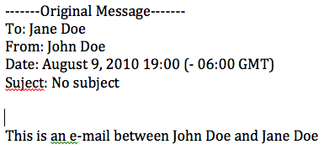
Details of Findings (Forensic Analysis) – cont.
A review of the Internet history using Internet Evidence Finder, the following data was recovered from sector 117004, which shows a Facebook email between John Doe and Jane Doe. Further analysis shows that John Doe logged into his Google Mail account.
See screenshots below:
E-mail between John Doe and Jane Doe.

Slide 19
Conclusion
In this section, you are basing your conclusion off the forensic evidence.
The goal of the forensic examination is to report the facts, regardless if the evidence is inculpatory or exculpatory in nature.

Slide 20
Supporting Materials (Appendices)
List supporting materials that are included with the report, such as printouts of particular items of evidence, digital copies of evidence, and chain of custody documentation.
Sample reports
Case No. 201088 Examiner Report
Case No. 201088 EMIA Report

Slide 21
Summary
There is no standardized report format.
The report can vary in length.
General guideline is to ensure report is cleared and detailed to avoid ambiguity.

Slide 22
Reference Books
John Ashcroft, Deborah J. Daniels, Sarah V. Hart, (Apr 04). Forensic Examination of Digital Evidence: A Guide for Law Enforcement. National Institute of Justice.
Notes:
Publisher: Cisco Press, Thomson Learning

